Slide 1
E(n) Equivariant Graph Neural Network

Slide 2
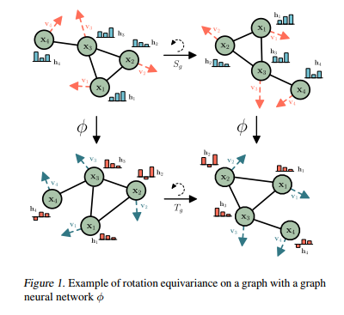
Introduction
The paper introduces E(n)-Equivariant Graph Neural Networks (EGNNs), a novel model for learning graph neural networks that are equivariant to rotations, translations, reflections, and permutations.
Unlike existing methods, EGNNs do not require computationally expensive higher-order representations in intermediate layers.
EGNNs are scalable to higher-dimensional spaces and perform competitively or better in various tasks such as dynamical systems modeling, representation learning in graph autoencoders, and predicting molecular properties.

Slide 3
Background
Equivariance: Ensuring that a function applied to transformed data results in a correspondingly transformed output. This is important for maintaining the symmetry properties of the data.
Graph Neural Networks (GNNs): Networks designed to operate on graph-structured data, maintaining permutation invariance of the nodes.

Slide 4
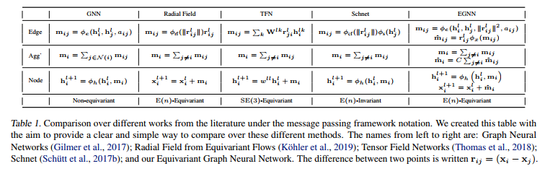
EGNN Architecisture
The model incorporates both node embeddings and their coordinates, ensuring translation, rotation, and reflection equivariance.
Equations defining the EGNN layer update node embeddings and coordinates, ensuring the model's equivariance properties.
The paper provides a formal proof that the EGNN model maintains E(n) equivariance for both translation and rotation.

Slide 5
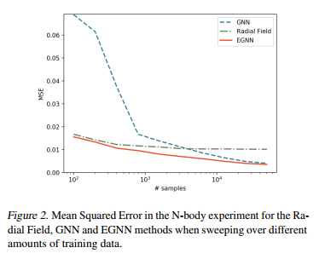
Experiments and results
Dynamical Systems Modeling (N-body Problem):
The task involves predicting the positions of particles influenced by physical forces.
EGNN outperformed other models like SE(3) Transformer, Tensor Field Networks, and standard GNNs in terms of accuracy and computational efficiency.

Slide 6
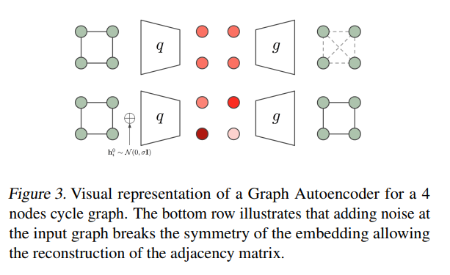
Experiments and results
Graph Autoencoder:
EGNNs were used to build an equivariant graph autoencoder.
The model successfully encoded and decoded graph structures, outperforming standard GNNs and radial field methods, especially in reconstructing sparse graphs.

Slide 7
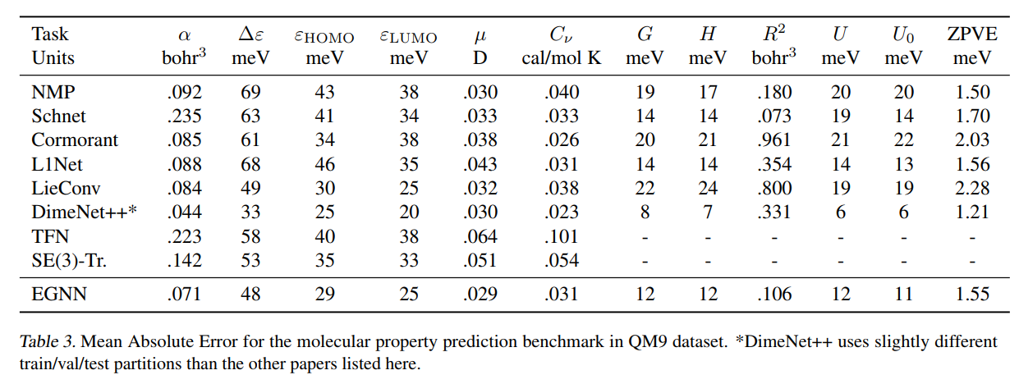
Experiments and results
Molecular Property Prediction (QM9 Dataset):
EGNNs were applied to predict various chemical properties of molecules.
The model achieved competitive results compared to state-of-the-art methods while remaining computationally efficient.

Slide 8
Conclusion
EGNNs represent a significant advancement in graph neural networks by combining simplicity, computational efficiency, and strong performance across multiple tasks.
The model's ability to handle higher-dimensional spaces and maintain equivariance makes it particularly suitable for applications in natural and medical sciences, such as drug discovery and material design.

